Slide 1
Open Car Data Cloud
Dr. Martin Berger Dr. Andreas Szinovatz

Slide 2
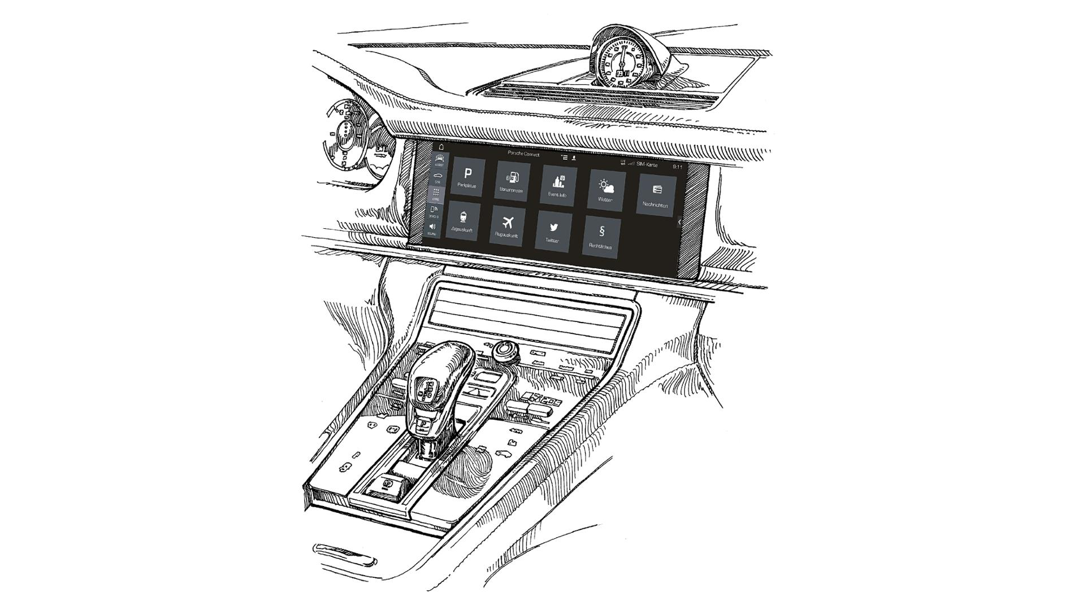
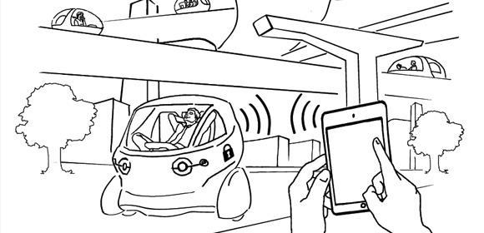
The future of car companies is data-driven!
In 1948 it was about a physical product…
… but the future
revenue pool is car data!
… in recent years
a lot has happened in car interior…
Porsche 356 B Cabrio

Slide 3
Opportunities according to McKinsey (Monetizing car data, September 2016)
$450b - $750b revenue pool by 2030

Slide 4
But: Car drivers will claim data ownership and control
Humans will fight that!
Do you want to become a
Datasucker in a Startrek-like world?

Slide 5
Resistance according to McKinsey (Monetizing car data, September 2016)
45% of car drivers do not want to share with 3rd parties

Slide 6
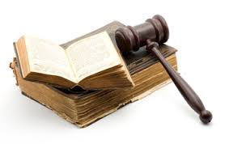
Legislation gives car drivers right
01-06-17: BfDI publishes 13 recommendations for data privacy laws on automated and connected mobility
25-05-18: EU General Data Protection Regulation gives control back to citizens and residents over their personal data

Slide 7
And: maintaining a data silo in a secure and privacy-preserving way is very hard!
Do you want be to responsible for the next big data breach?
How to compete with established data-collectors like Google & Co?

Slide 9
Our solution: Open Car Data Cloud (OCDC)
Aggregate, encrypt & store car data in a bullet-proof secure, tamper-proof & reliable blockchain of OCDC
Give drivers flexible control and ownership of the car data
Allow drivers to exchange car data with whom they want to & for purposes that matter to them
Enable an open permission-less marketplace where 3rdparties can innovate services on car data

Slide 10
Architecture
Open Car Data Cloud
Car owner
Self Service (Car Dashboard/App/Web)
Decryption
Full Data
Grant View Permissions to 3rd-Parties
Car owner
Define Aggregation Rules
Car
Aggregation
DedicatedData
Decryption
Data source
Encryption
Car Data Blockchain
Insurance
Decryption
DecicatedData
Car manufacturer
© ITP 2017

Slide 11
Business Model – Revenue
Revenue sharing on exchanged car data
3rd party pays for getting car data
70% share goes to the car driver
30% share is the fee to use OCDC (development, operations, maintenance…)
Open car data cloud
Car driver

Slide 12
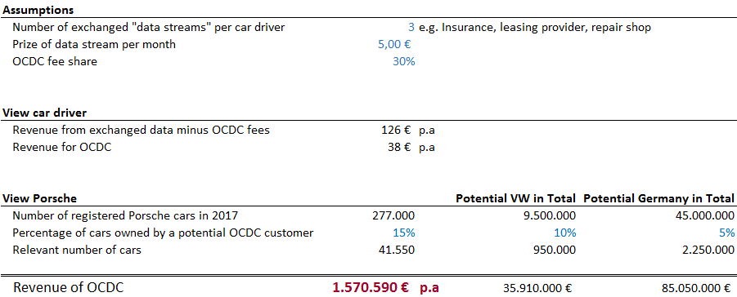
Business Model – Potential

Slide 13
Benefit for OCDC players
Car driver
Become leader in tech- & data-driven car industry
3rd parties
Flexible, open & user-approved access to specific car data
Flexible control and ownership of car data
Car manufacturer
Fair incentive/revenue on data exchange
Trustful and verifiable blockchain data storage
More positive-annotated exposure to car drivers
Gain as brand by offering value-adding services from innovative 3rd parties
Reduce costs for collection and storing data
Reducing costs for data acquisition
© ITP 2017

Slide 14
3rd parties Generating revenues, reducing costs, increasing safety
Insurance companies
Fleet management
Suppliers of OEM
Telematics services
Car repair shops
Smart home functionalities
Infotainment
Retailers
…
Selling products, features, or services to the customer
Tailored advertising
Gathering product field data for development
Analyzing actual usage patterns to reduce maintenance costs
Collecting and forwarding warnings in real time

Slide 15
Benefit for Porsche
Take data privacy with a user-centric approach seriously
Strengthen position as Innovation leader
Additional revenue streams
Legal requirement

Slide 16
What other‘s do?
22-05-17
30-05-17
24-03-17

Slide 17
Action Plan: March-April 2017 - Concepts
Technical feasibility study to realize OCDC with blockchain and smart contracts
Evaluation of blockchain technologies
Concepts for encryption and aggregation

Slide 18
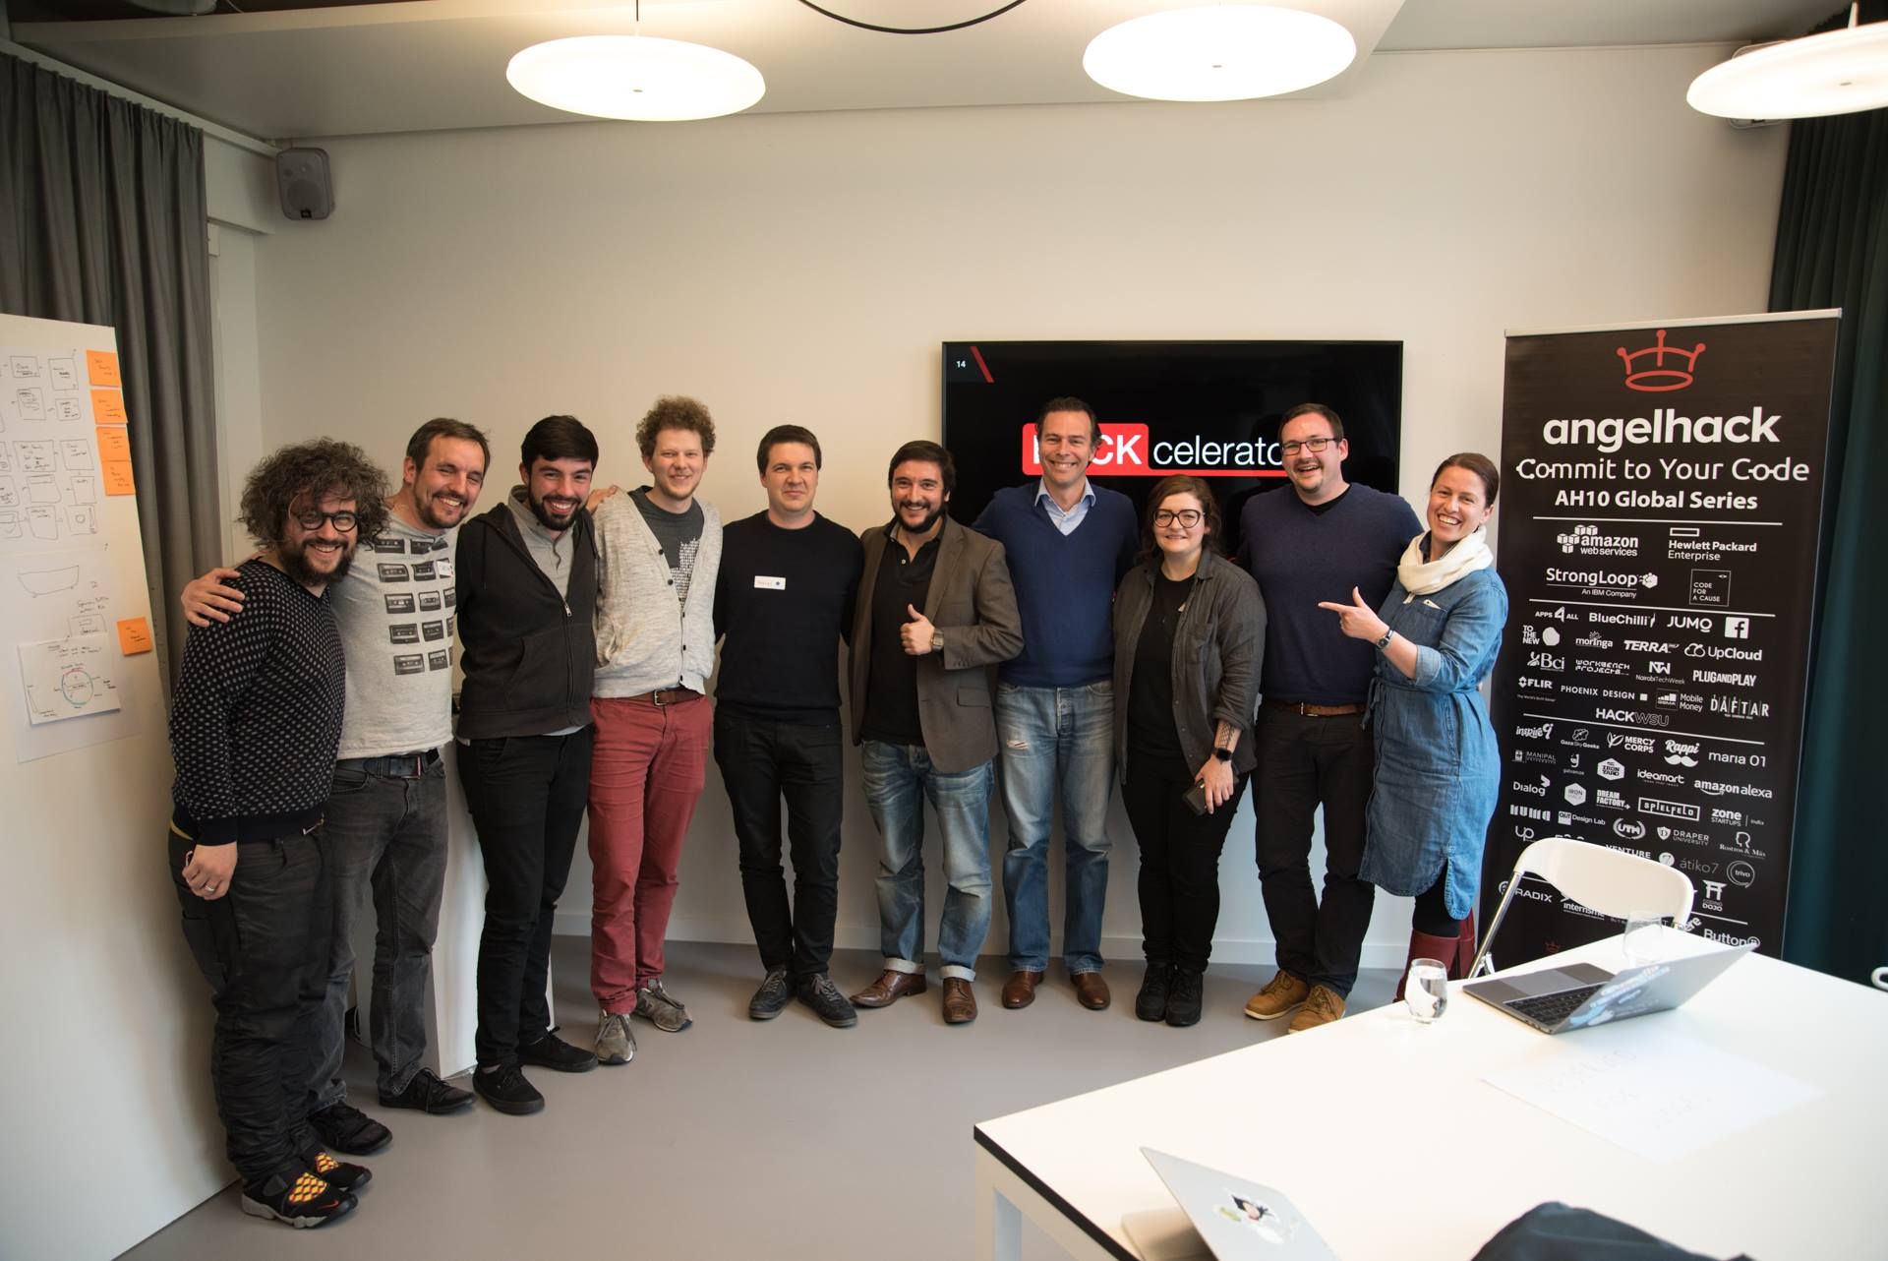
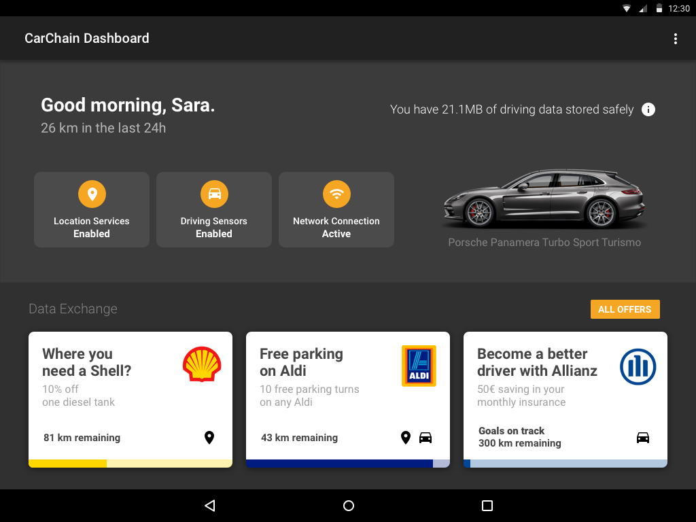
Action Plan: May-June 2017 - Prototyping
2nd in Grand Prize Challenge of
angelhack Global Hackathon Series Munich
Jury & winner team Design: Eduardo Osorio eduardo@ebpo.design Code: Gabriel Zink info@gabrielzink.de Jakob Niggel jakobniggel@gmail.com Martin Berger martin.berger@itp-world.com

Slide 20
Action Plan: May – August 2017
Looking for key partners!
Car manufacturers
Telematics service providers
Insurance companies
Other 3rd parties interested in car data
Start research project to integrate IoT Message Broker

Slide 21
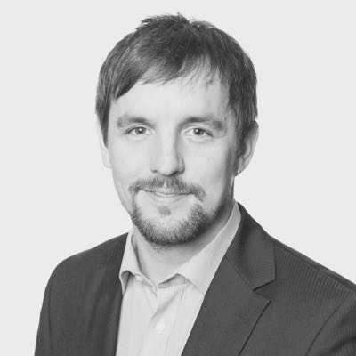
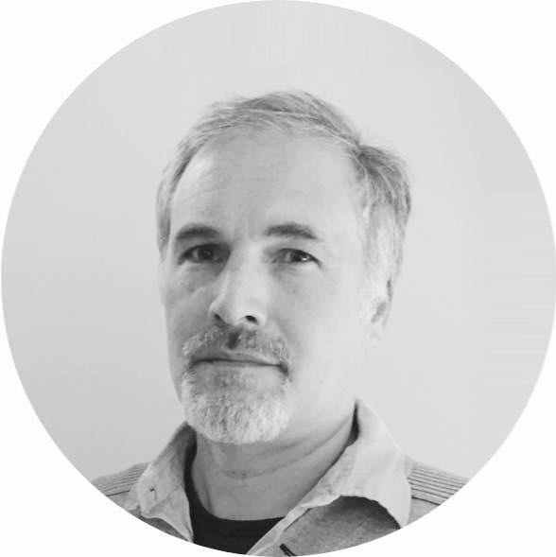
Team
Dr. Martin Berger
Head of Innovation Lab
Mathematician, Blockchain Expert, Allrounder
Dr. Andreas Szinovatz
CEO
Computer Scientist, Founder, Visionary
Andreas Deil
Lead Developer
Physicist, Linux-er, Perfectionist
Christoph Curtius
Automotive Domain Expert
Business Analyst, Project Manager, PMP
ITP Innovative Technologie Projekte GmbH
Karwendelstraße 39
12203 Berlin
Geschäftsführer: Dr. Andreas Szinovatz
Amtsgericht Charlottenburg, HRB 124473 B
Telefon: 030-67965611 www.itp-world.com

Slide 22
Open Car Data Cloud

